Slide 1

WOMEN EMPOWERMENT & LIVELIHOOD
Maharaja Sayajirao University of Baroda Faculty of Science
Department of Statistics
Presented By-
Riddhi Parmar Vaishali Sharma Harsh Prajapati Smriti Verma Aadhya Dangar Hiren Solanki Nikita Saroj
- GUIDED BY
Dr. MANISHA PANDYA

Slide 2
Table of contents
02
01
Aims & Objectives
Introduction
04
03
Data Visualization
Data Sorting & Filtering
06
Conclusion
05
Analysis
07
Source of Data

Slide 3
Introduction!

Slide 4
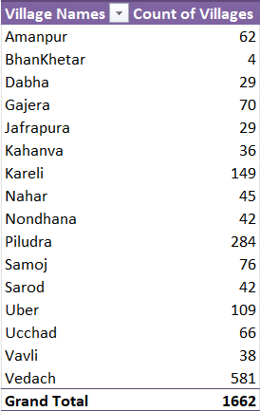
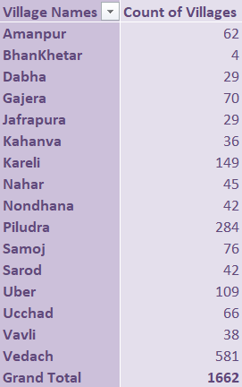
Introduction
Details-
Our data is a Secondary type of data
Data is provided by the Aatapi Organization
Data is collected from Jambusar taluka of Bharuch District, Gujarat.
The data is collected from the year 2015
Our sample size consists around 1660 observations.
Since, there was large set of unorganized data we have filtered and sorted the data firstly.
Secondly we have filtered out the data according to our objectives only .

Slide 5
Data Sorting & Filtering

Slide 6
Work carried out
Improvement made with Analysis part
Work done
Data Sorting, Cleaning, Translating
Data Representation
Data Visualization
Objective wise
Analysis

Slide 7
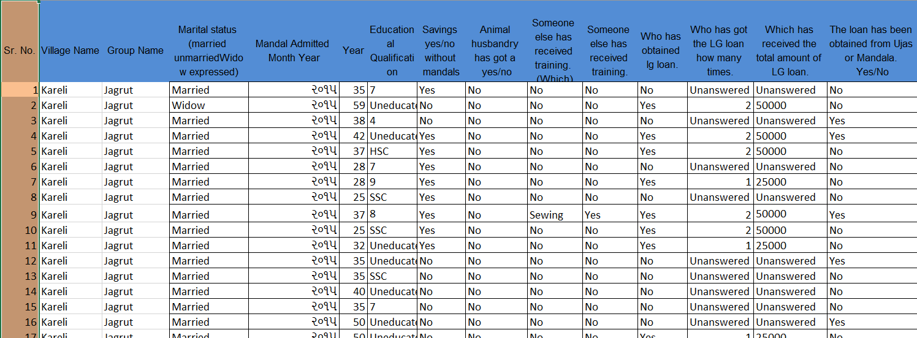
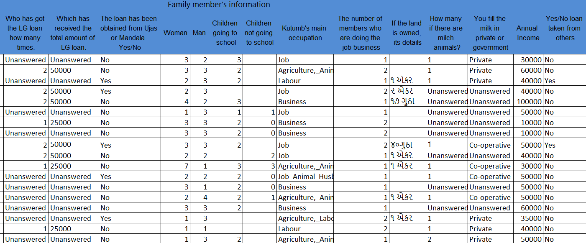
Translated Data
VARIABLES ARE AS FOLLOWS
Village name
Group name
Marital status
Mandal admitted Year
Age
Qualification
Savings
Animal Husbandry
Received any training
Obtained LG loan or any other
Loan amount and times loan received
Family member’s information
Family occupation
Land Ownership
Number of animals
Annual income
Milk supplement

Slide 8
Aims & Objectives

Slide 9
Aim & Objectives
Analyzing how the living standard has changed over time for women of Jambusar block.
1. Comparative Study
2. Income Demographic Analysis
To evaluate the changes by appropriate comparisons from baseline to endline to get appropriate results to work more on economic backward one.
To analyze average financial status(income) with respect to demographic variables.
3. Predictive Analysis
4. Financial Dynamics
Estimating the condition if individual will take loan or not and of what amount will they pursue by analysing income levels and other relevant factors.
Estimating the condition if individual will take loan or not and of what amount will they pursue by analysing income levels and other relevant factors.

Slide 10
Data Visualization
Software used – Microsoft Excel is used for Data Visualization.

Slide 11
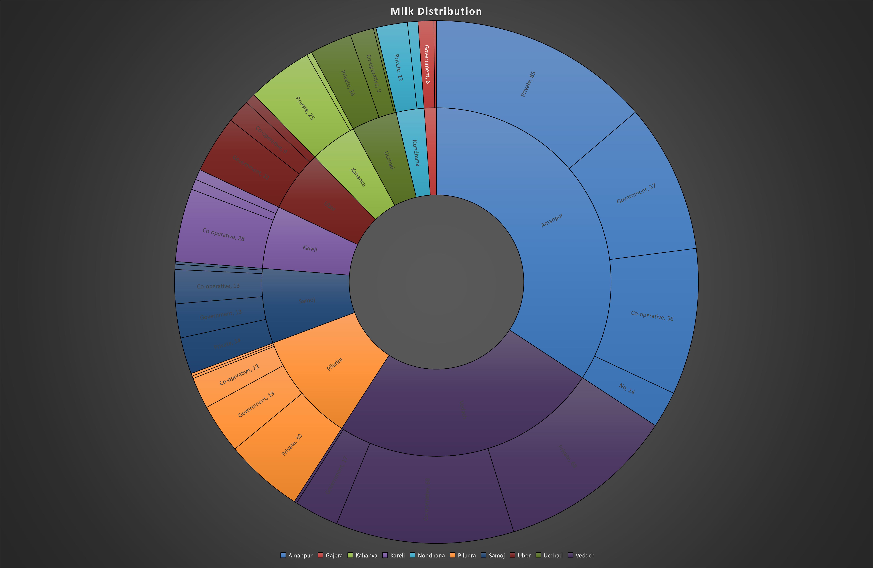
Milk Distribution
Village wise milk distribution among different categories (private, government, corporate)
Interpretation- It can be observed that Amanpur and Vedach are the large milk distributors among all 10 villages contributing about 60% of total. Around 40% of population of Amanpur’s residents sells their milk to Private Dairy & 44-44% each for private and co-operative dairy in Vedach village.

Slide 12
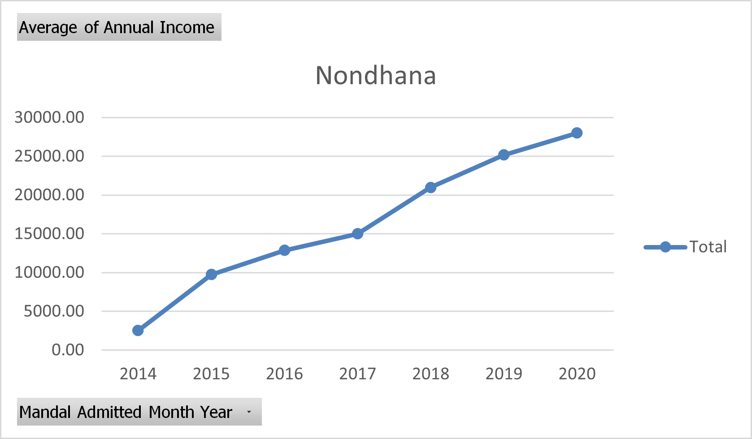
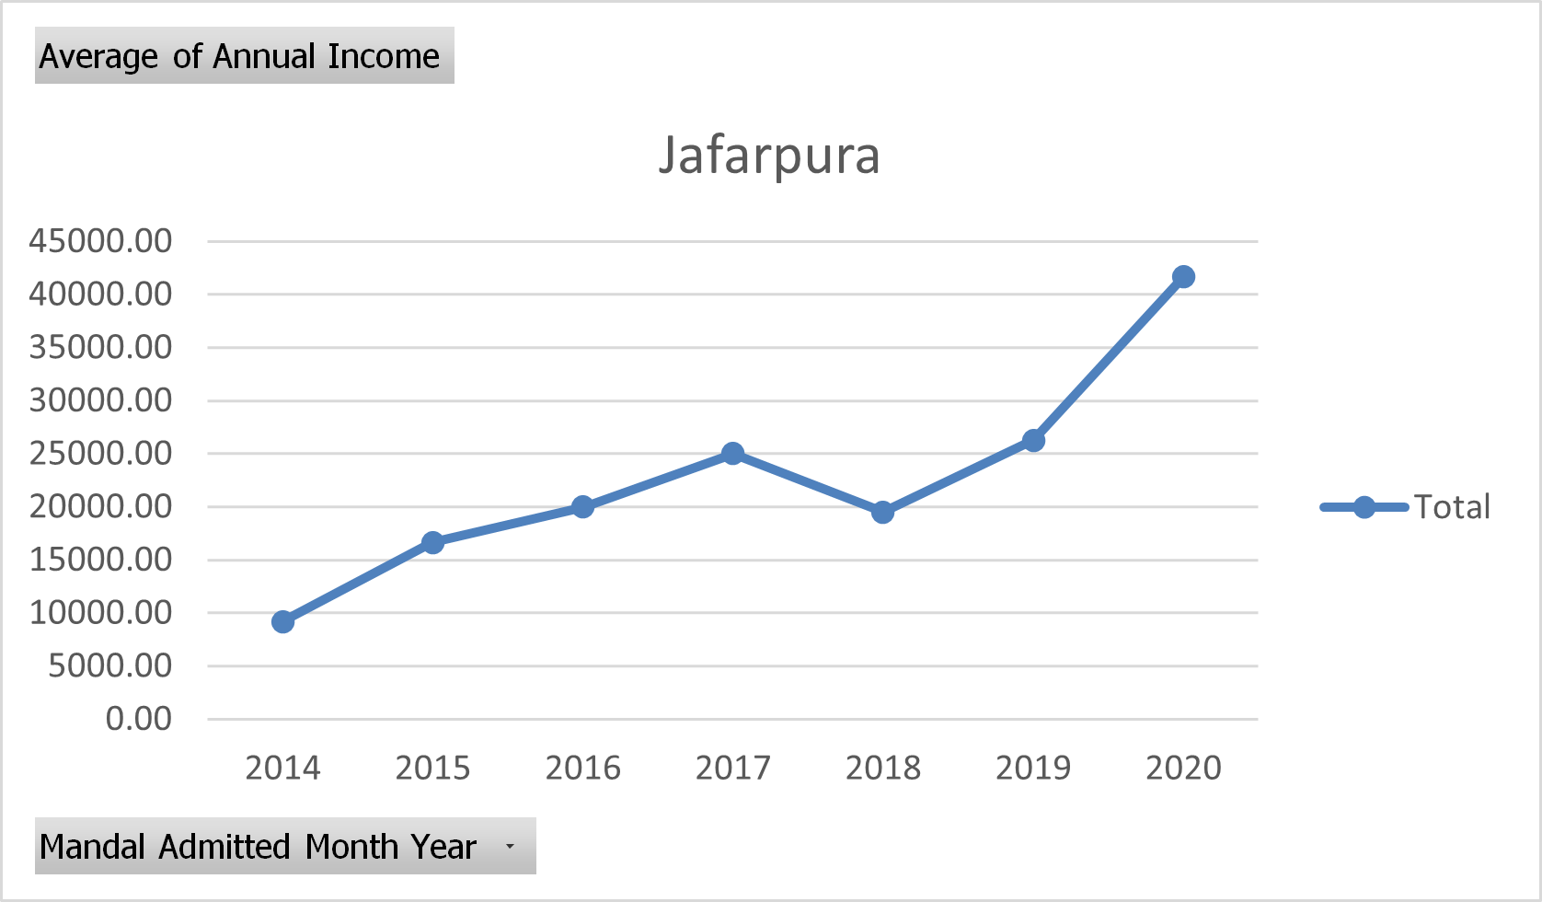
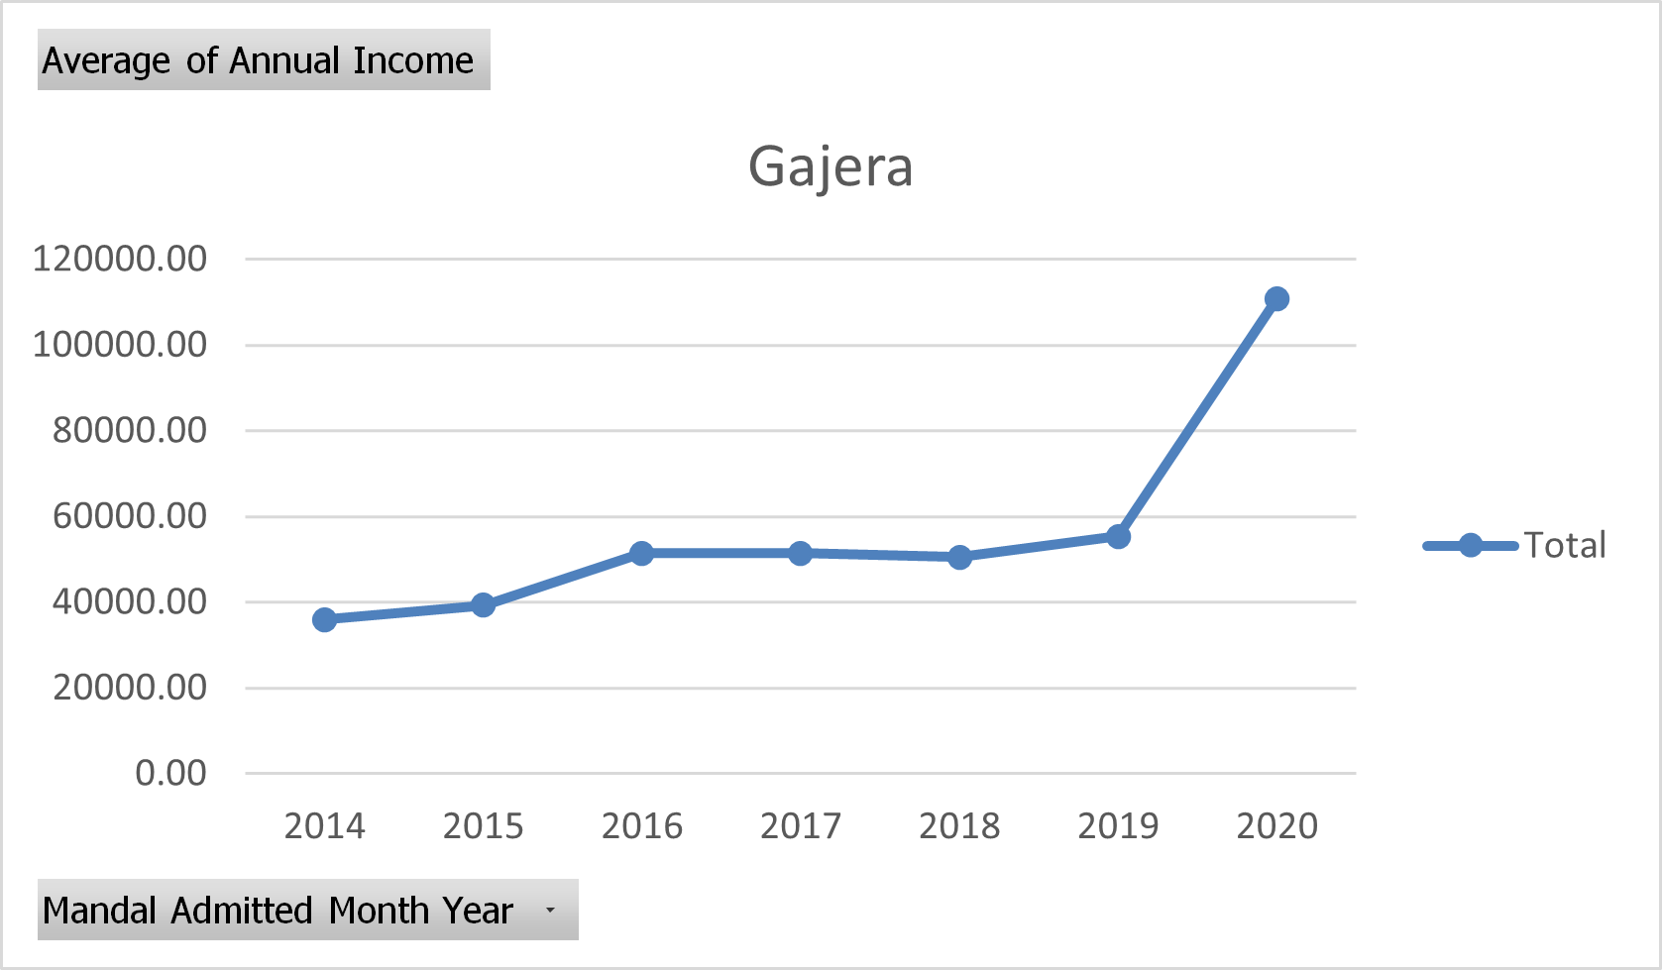
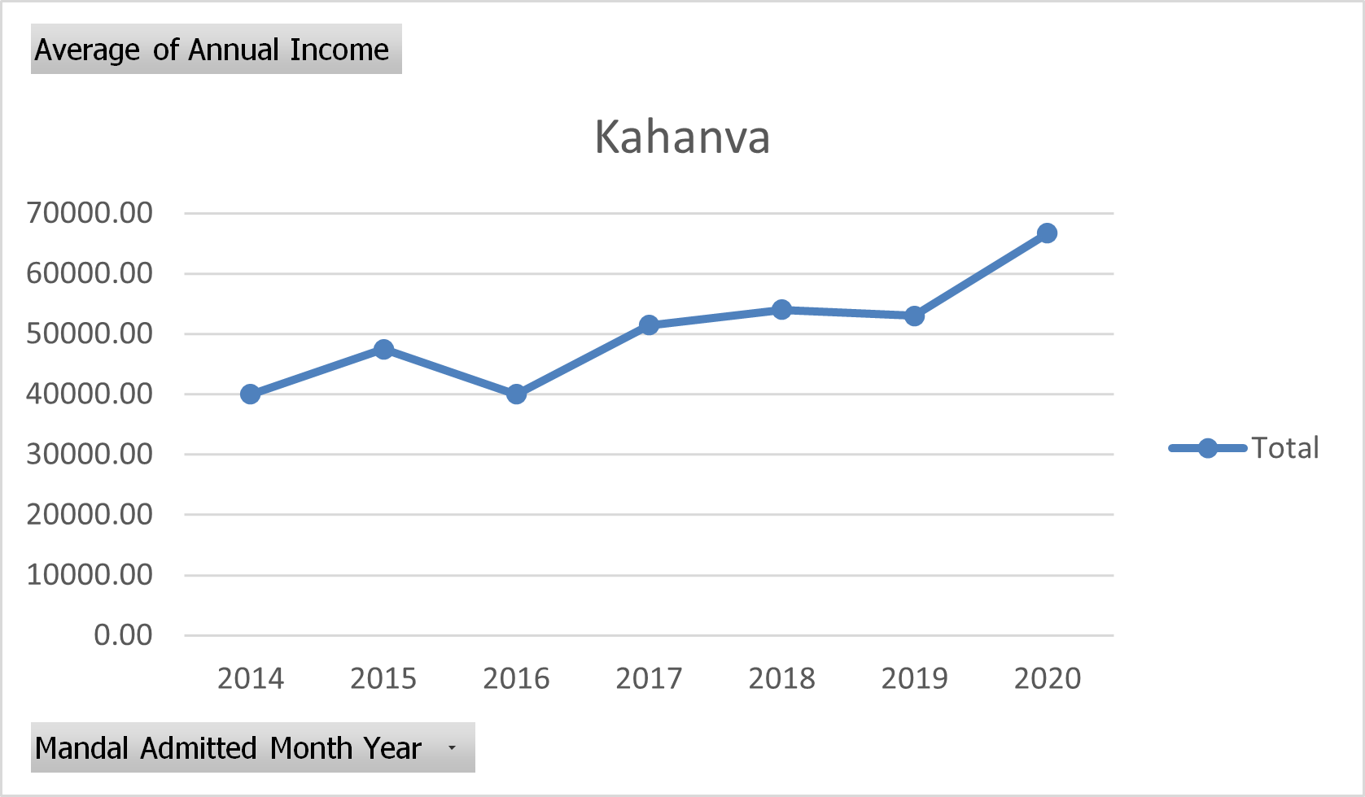
Village wise Average Income Representation

Slide 13
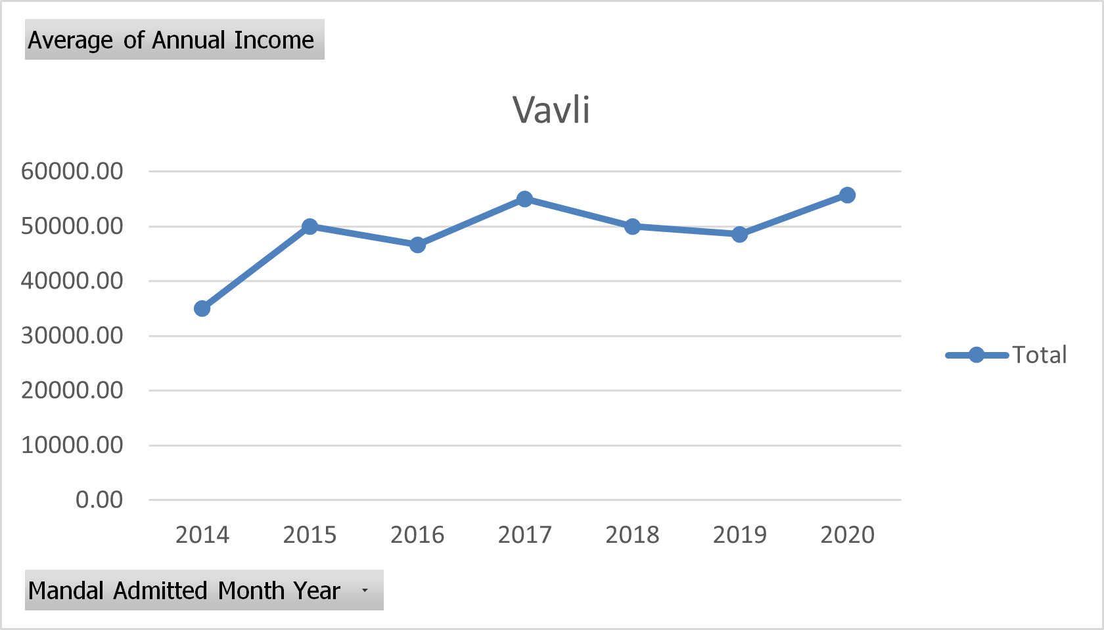
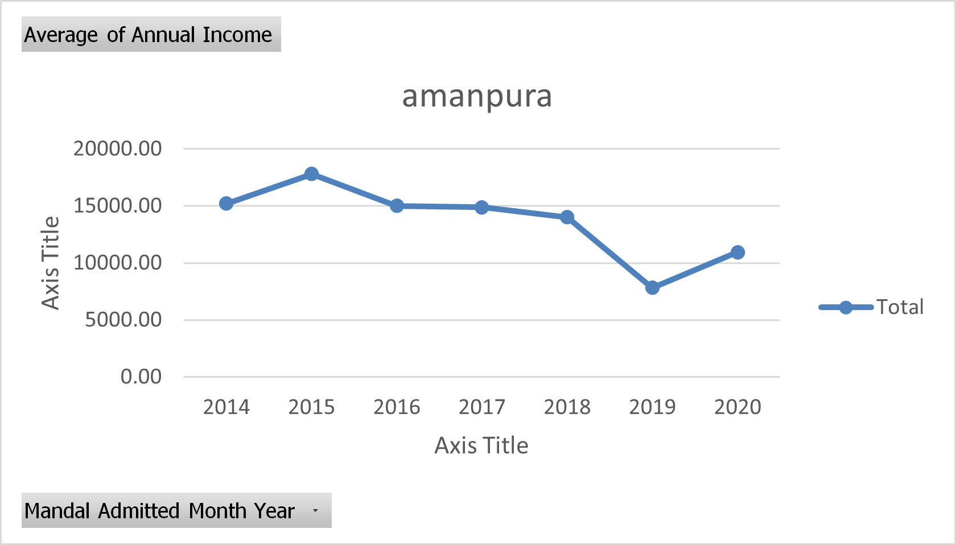
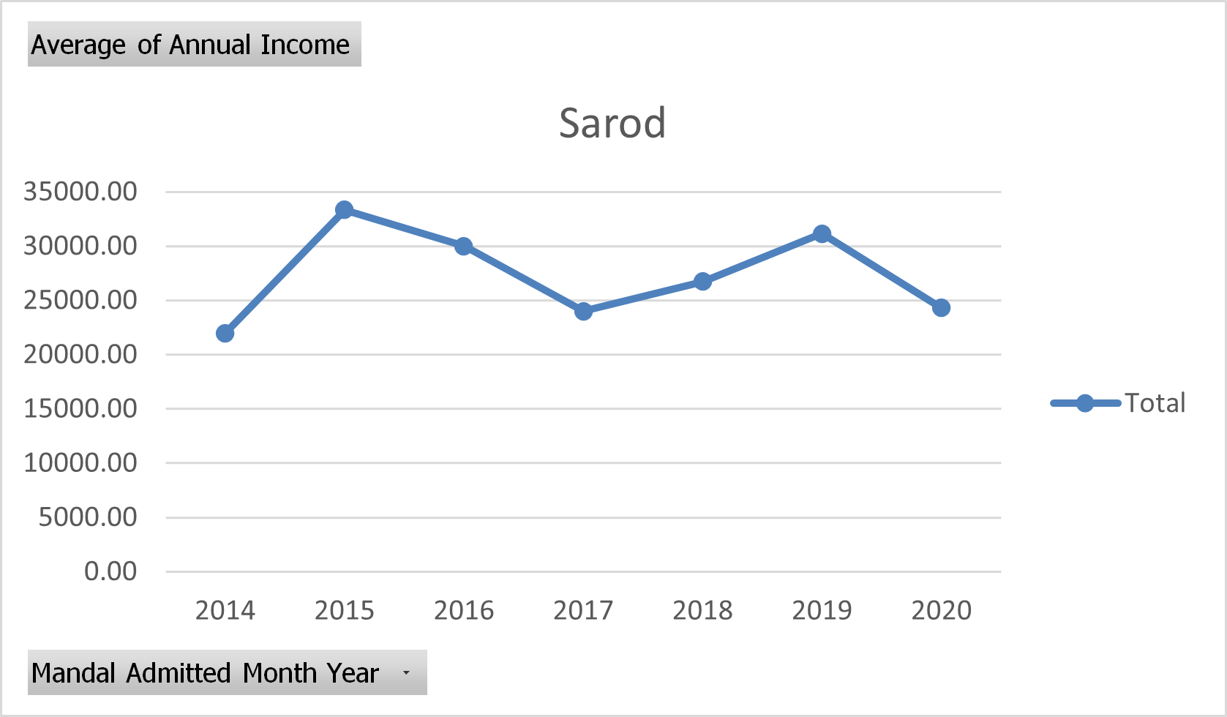
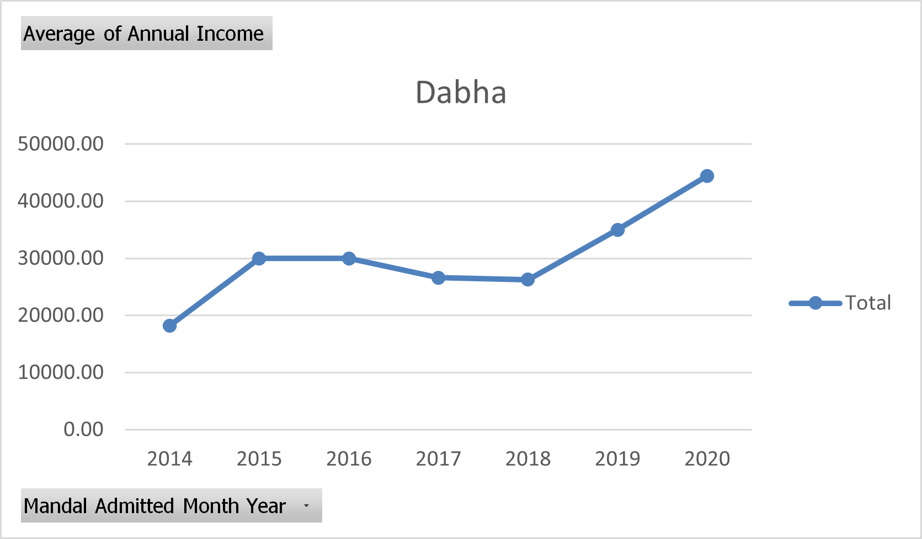

Slide 14
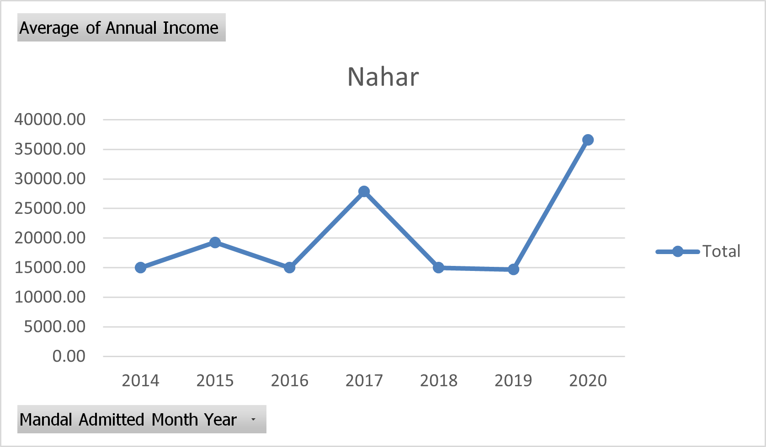
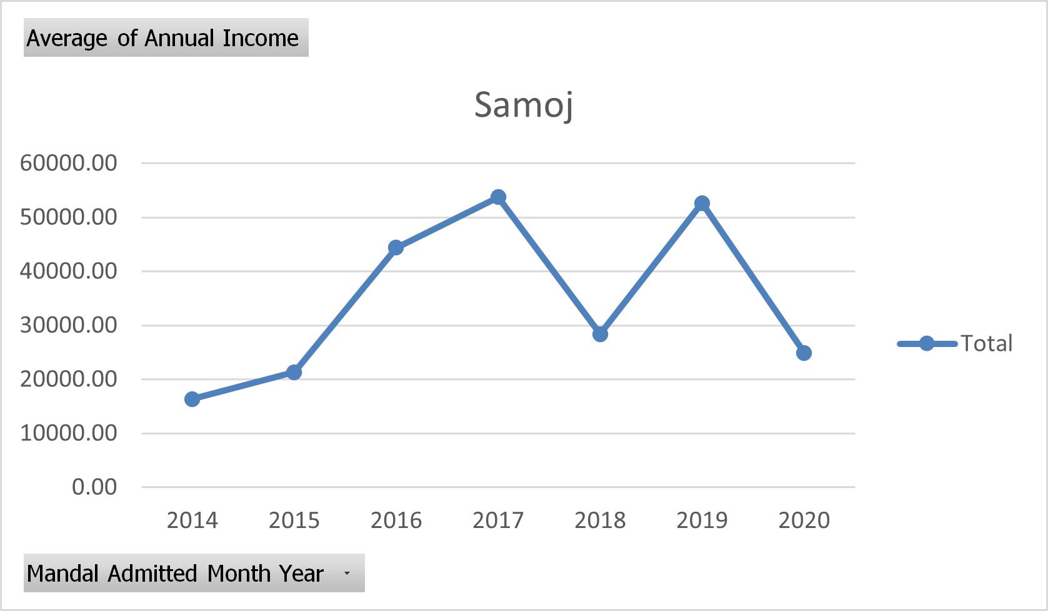
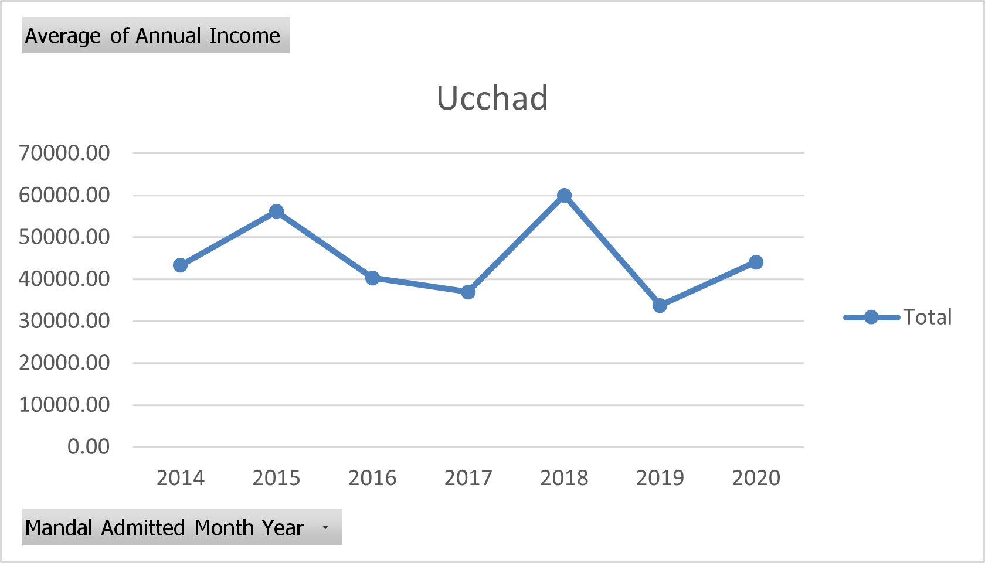
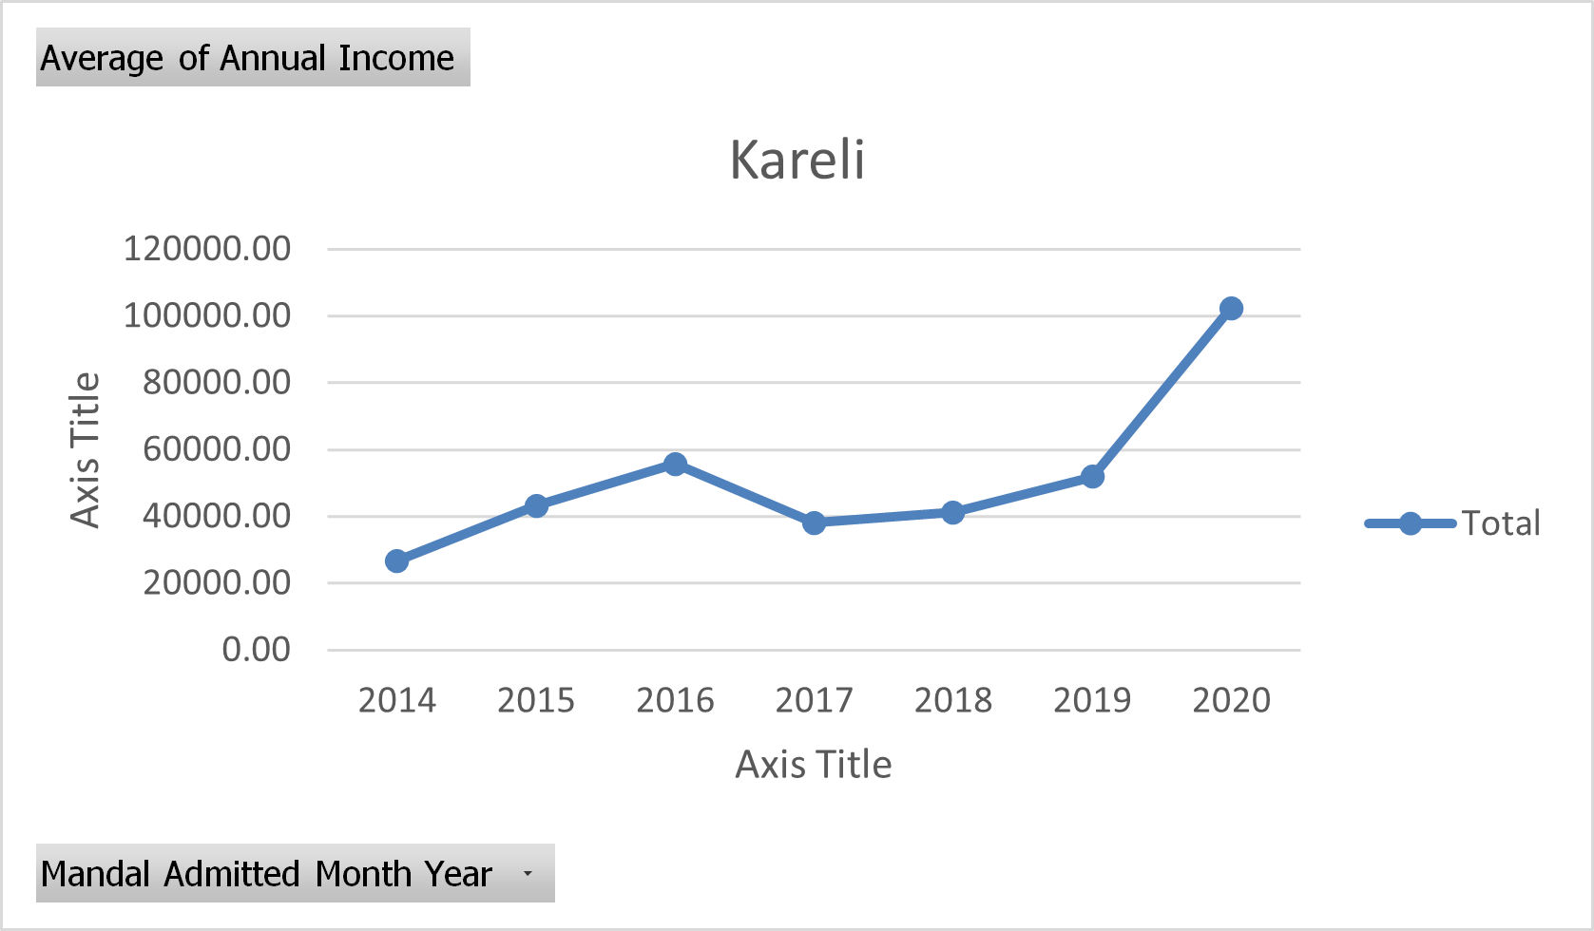

Slide 15
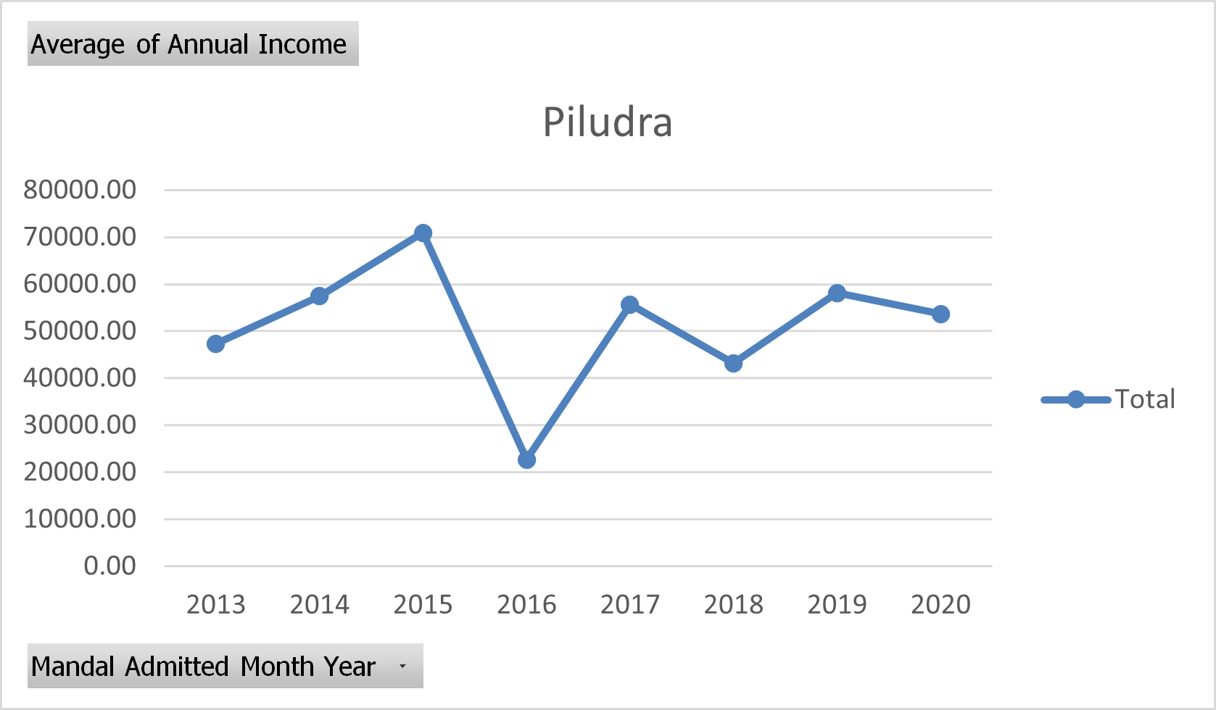
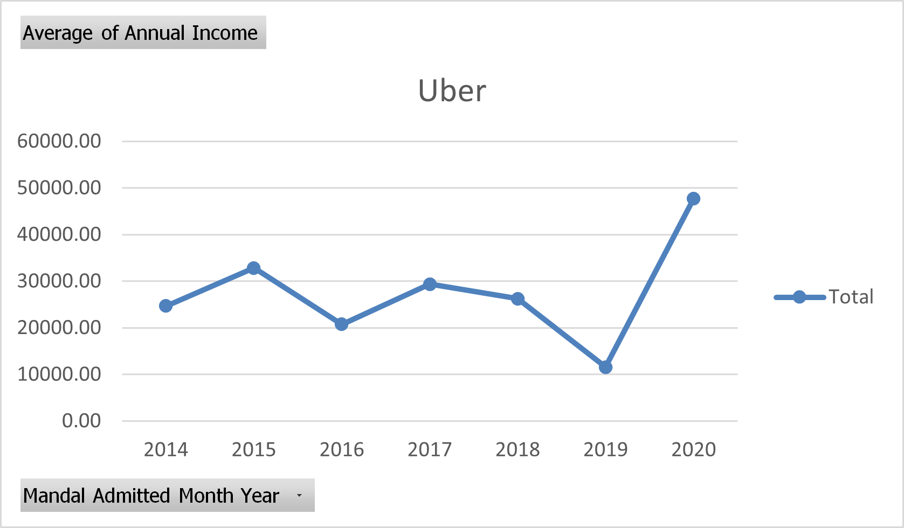
Interpretation: Nondhana and Jafarpura income increasing showing positive change; vavli- moderate increase; amanpur, sarod, samoj, Ucchad, piludra- decrease in average income

Slide 16
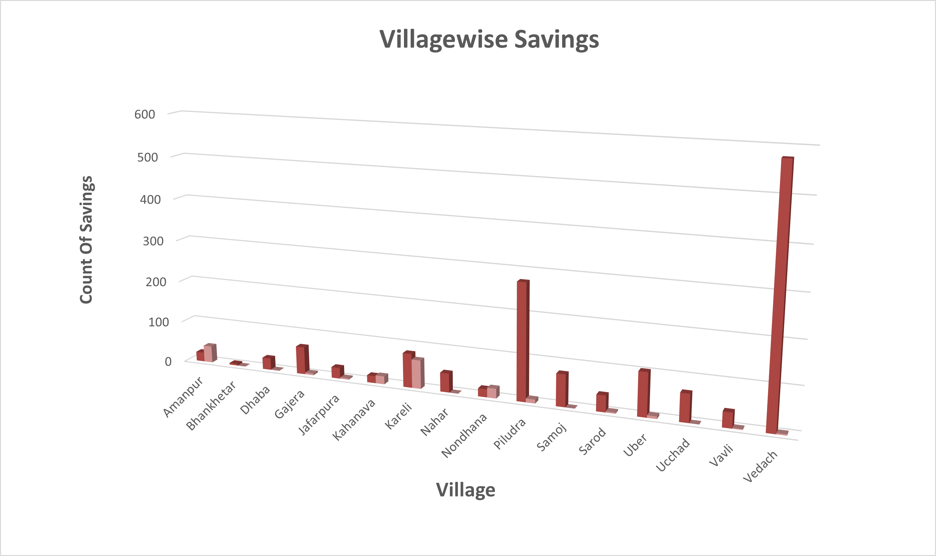
Village wise Saving
Interpretation: Vedach have the highest no. of savings in comparison to other villages of Jambusar.

Slide 17
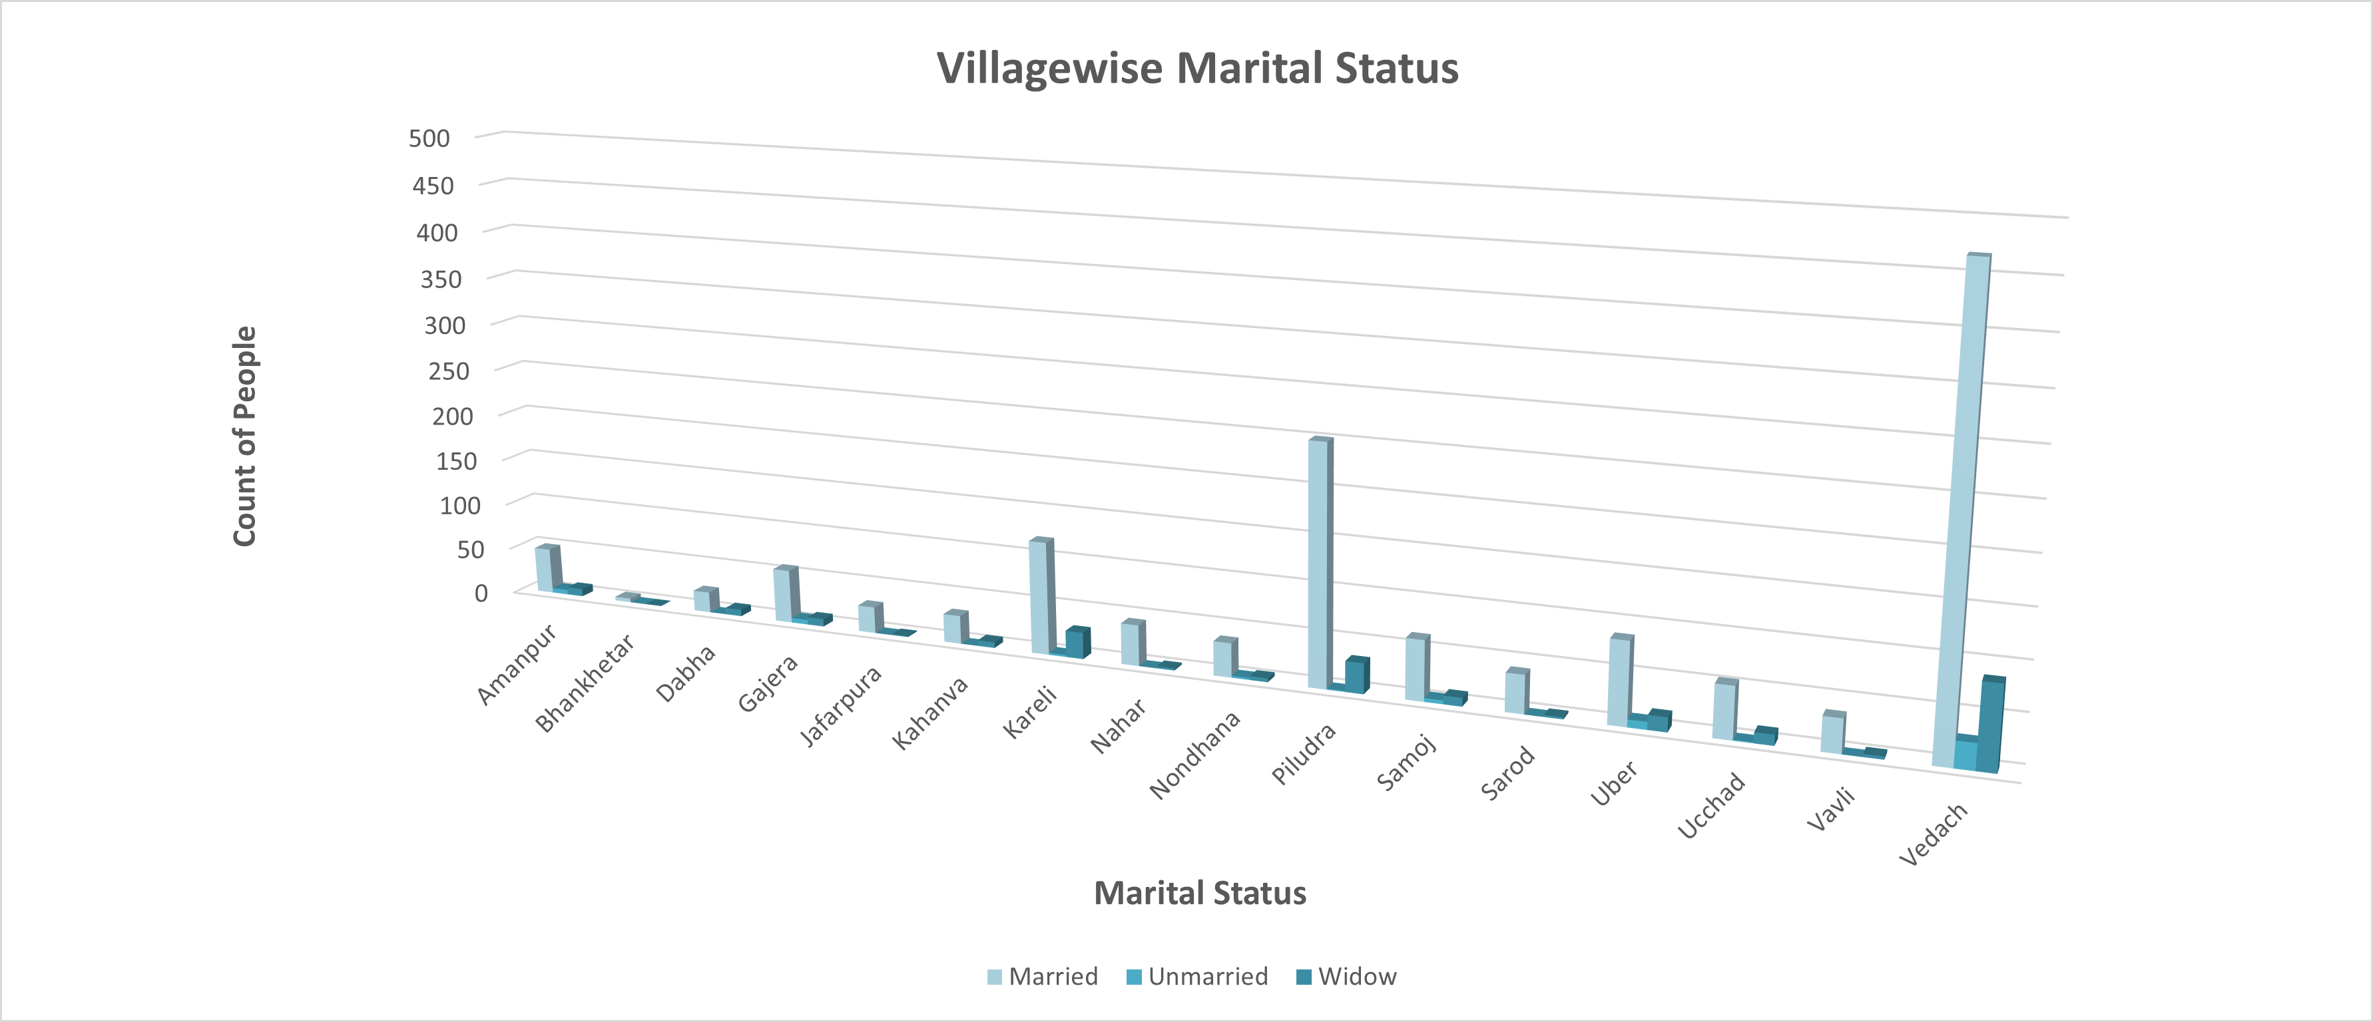
Village wise Marital Status
Interpretation: Vedach have the highest no. of married women residing in it in comparison to other villages of Jambusar.

Slide 18
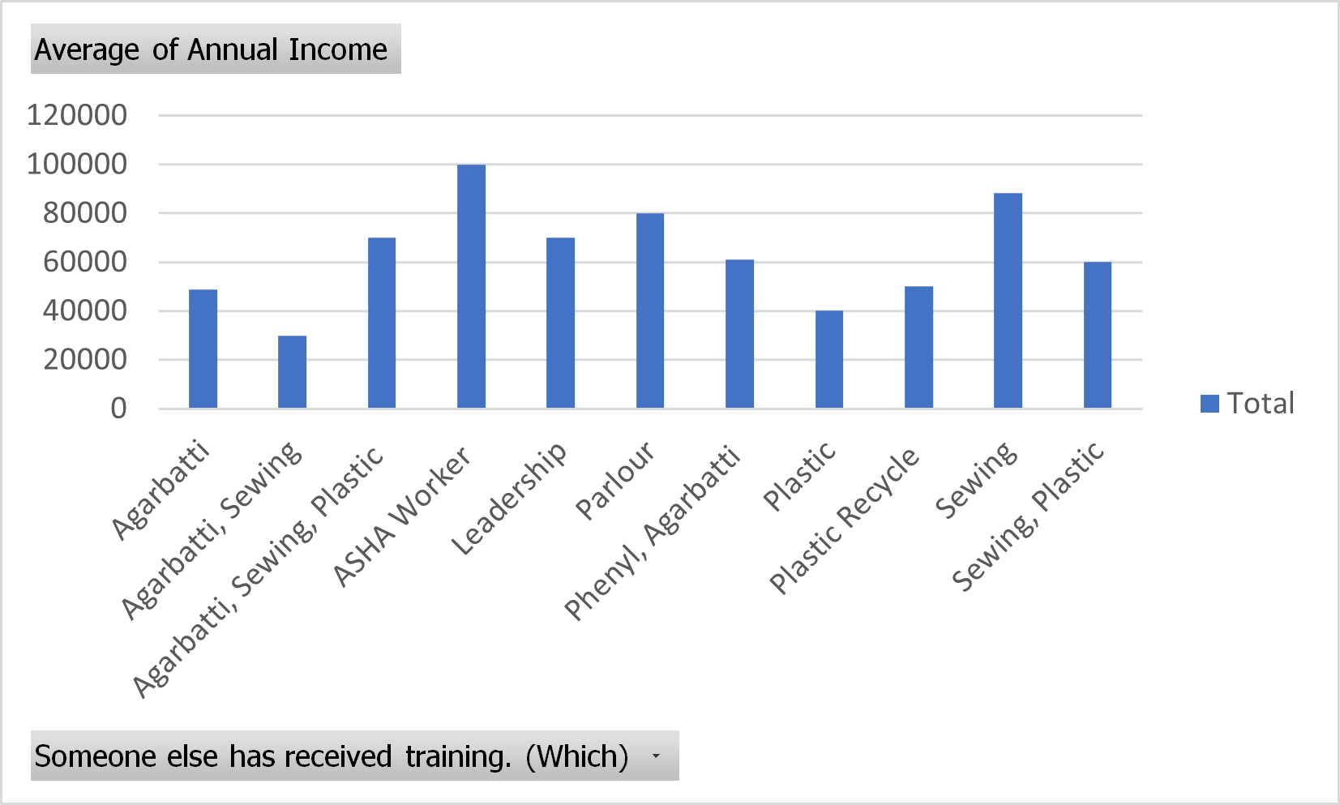
Average Income based Training Received
Interpretation: ASHA workers have the highest average annual income according to the training provided, followed by sewing workers.

Slide 19
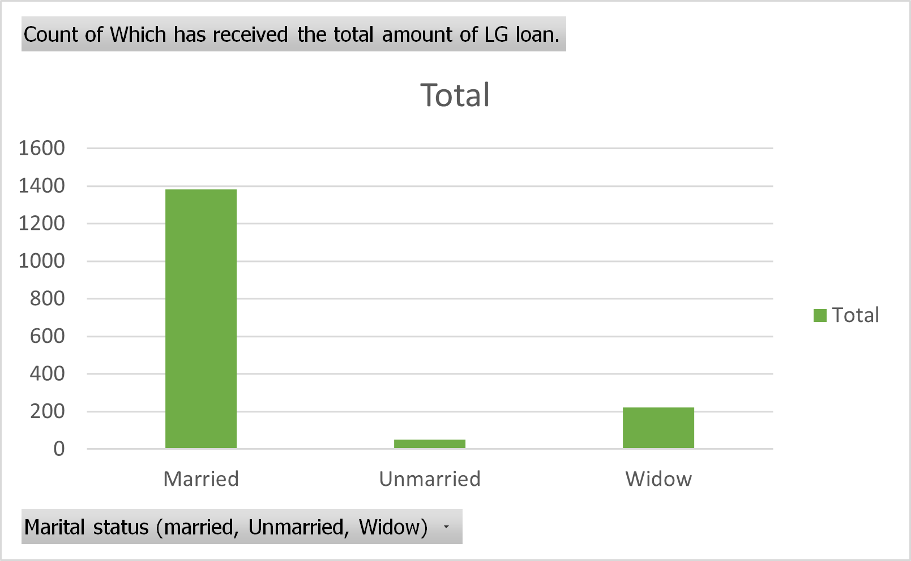
Loan received based on Marital Status
Interpretation: Married women are accessing JLG loan at higher rate than widow,
unmarried women.

Slide 20
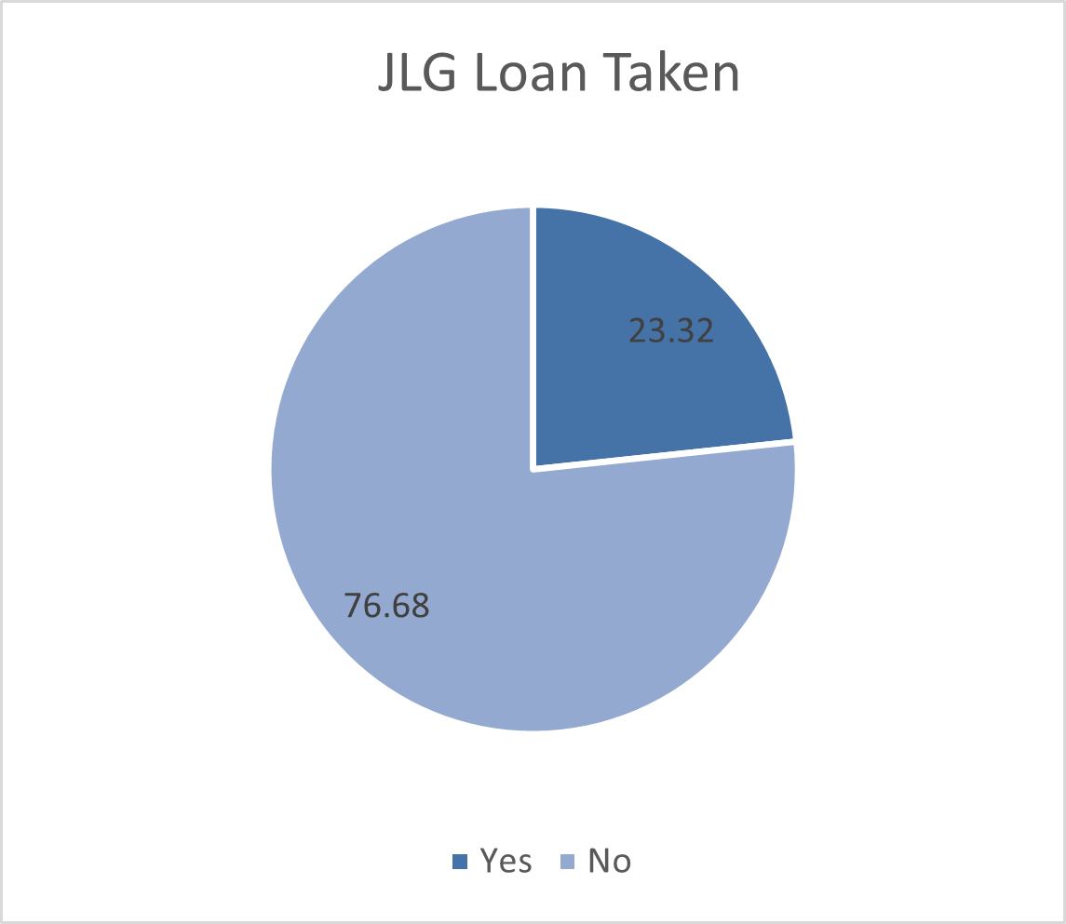
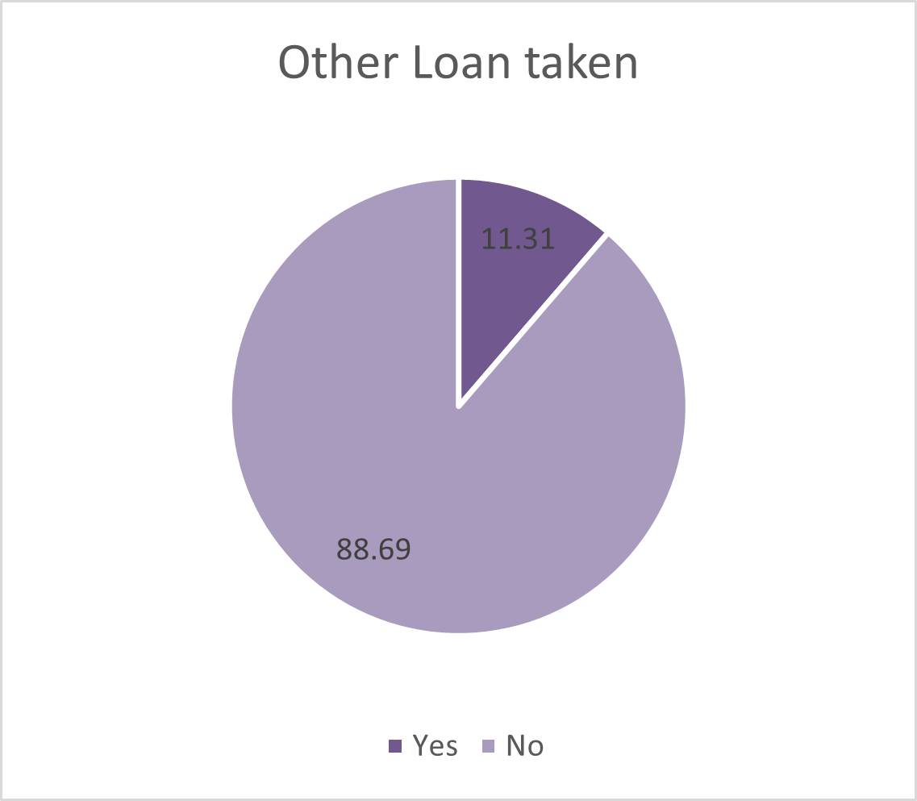
Loan Taken
Yes/No percentage of loan taken; JLG is preferred 76.68% as compared to any other loan taken which is preferred 88.69%.

Slide 21
02
Analysis
Software used- Microsoft excel & R-Studio

Slide 22
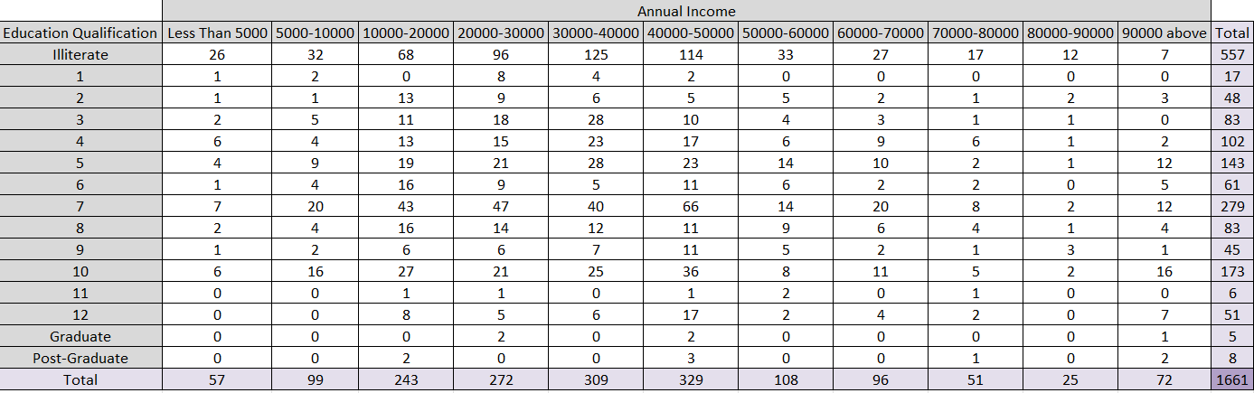
Chi-Squared Test for Independence
To check the independence between two variables (Education Qualification & Annual Income), we have applied Chi Squared test for independence.

Slide 23
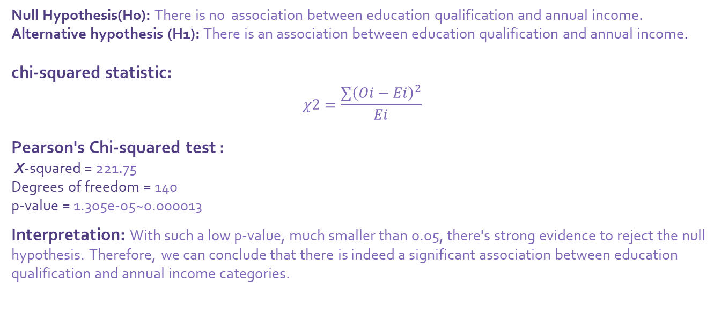
Continued…
Null Hypothesis(H0): There is no association between education qualification and annual income.
Alternative hypothesis (H1): There is an association between education qualification and annual income.
chi-squared statistic:
$$χ2=\frac{∑{\left(Oi−Ei\right)}^{2}}{Ei}$$
Pearson's Chi-squared test :
X-squared = 221.75
Degrees of freedom = 140
p-value = 1.305e-05~0.000013
Interpretation: With such a low p-value, much smaller than 0.05, there's strong evidence to reject the null hypothesis. Therefore, we can conclude that there is indeed a significant association between education qualification and annual income categories.

Slide 24
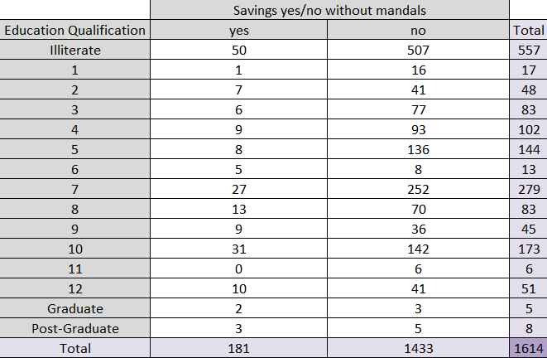
Chi-Squared Test for Independence
To check the independence between two variables (Education Qualification v/s Savings (yes/No) without mandals, we have applied Chi Squared test for independence.

Slide 25
Continued…
Null hypothesis (H0): There is no association between education qualification and savings.
Alternative hypothesis (H1): There is an association between education qualification and savings.
Pearson's Chi-squared test
X-squared = 47.757
Degrees of Freedom = 14
p-value = 1.442e-05 ~0.000014
Interpretation: Since p-value is extremely low (less than 0.05), we reject out Null Hypothesis H0; i.e. the results suggest that there is indeed a significant association between education qualification.

Slide 26
Summary of Chi-Squared Test
 | Null Hypothesis | Alternative Hypothesis | P-value | Conclusion
Education Qualification V/s Annual Income | There is no association between education qualification and annual income. | There is an association between education qualification and annual income. | 0.000013 | Reject H0 at level of significance 5%
Education Qualification V/s Savings | There is no association between education qualification and savings. | There is an association between education qualification and savings. | 0.000014 | Reject H0 at level of significance 5%

Slide 27
TESTING CORRELATION
For testing correlation among loan and average income w.r.t. property area. We have created a (4*4) correlation matrix of Dependant, Annual Income, Loan amount, property area owned.
 | Dependent | Annual Income | Loan Amount | Property Area
Dependent | 1 | 0.080618 | 0.005099484 | 0.01653889
Annual Income | 0.080618 | 1 | 0.118105451 | 0.06923162
Loan Amount | 0.005099484 | 0.11810545 | 1 | -0.02461581
Property Area | 0.016538889 | 0.06923162 | -0.024615813 | 1

Slide 28
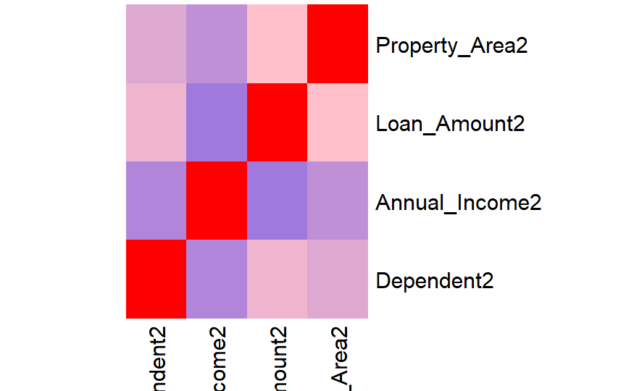
Heatmap to visualize the correlation Matrix!
INTERPRETATION-
For Dependent:
It has a very weak positive correlation with Annual Income (0.0806), suggesting a minimal tendency to increase together.
as an extremely weak positive correlation with Loan Amount(0.0051) and Property Area (0.0165), indicating almost no linear relationship.

Slide 29
For Annual Income:
It has a very weak positive correlation with Dependent (0.0806), implying a slight tendency to increase together.
It has a weak positive correlation with Loan Amount (0.1181), indicating a slight tendency for loan amounts to increase with higher incomes.
It also shows a weak positive correlation with Property Area (0.0692), suggesting a slight tendency for larger property areas to be associated with higher incomes.
For Loan Amount:
It has an extremely weak positive correlation with Dependent (0.0051), indicating almost no linear relationship.
It has a weak positive correlation with Annual Income2 (0.1181), suggesting a slight tendency for loan amounts to increase with higher incomes.
It has a very weak negative correlation with Property Area (-0.0246), implying a minimal tendency for larger loan amounts to be associated with slightly smaller property areas.
For Property Area:
It has an extremely weak positive correlation with Dependent (0.0165), indicating almost no linear relationship.
It has a weak positive correlation with Annual Income (0.0692), suggesting a slight tendency for higher incomes to be associated with larger property areas.
It has a very weak negative correlation with Loan Amount (-0.0246), implying a minimal tendency for larger loan amounts to be associated with slightly smaller property areas.

Slide 30
CONCLUSION
After conducting an analysis of the data, it can be concluded that there is a positive impact on women empowerment and livelihood. Increased education levels leading to higher incomes, Educated people preferring more JLG loan than any other, increased income level over time for maximum villages. These findings suggest that efforts aimed at empowering women, such as education initiatives and economic support programs have resulted in tangible improvements in women's lives, enhancing their economic independence, decision-making power, and overall well-being.

Slide 31
SOURCE OF DATA
Data provided by:
AATAPI SEVA FOUNDATION
Address: -
Aatapi Seva Foundation Registered Office:- A-901, Alkapuri Arcade, R.C. Dutt Road, Vadodara, Gujarat, India- 390007
Mail address: -
hr.aatapi@gmail.com
ceo@aatapi.org
Website Link:
click here.

Slide 32
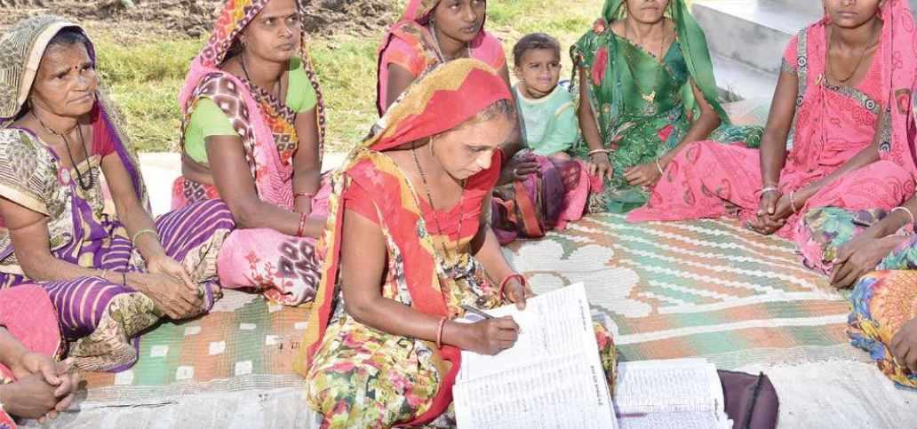
Thank You!

